Slide 1
Books for Memorial Day

Slide 2

The Poppy Lady
By: Barbara Elizabeth Walsh

Slide 3
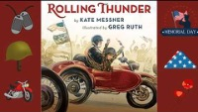
Rolling Thunder
By: Kate Messner

Slide 4
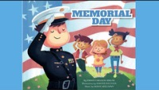
Memorial Day
By: Emma Carlson Berne

Slide 5

Why Do We Celebrate Memorial Day?
By: Kirsten Lake

Slide 6

F Is for Flag
By: Wendy Cheyette Lewison

Slide 7
References
www.youtube.com
www.google.com

