Slide 1
Pledge of Allegiance meaning

Slide 2
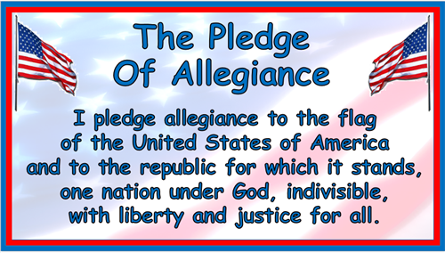

Pledge of Allegiance

Slide 3
I pledge allegiance
I promise my support and loyalty

Slide 4
to the flag of the United States of America
to the flag which represents all 50 states and territories that together make one nation

Slide 5
and to the republic for which it stands,
and I promise my support and loyalty to the government represented by the flag

Slide 6
one nation under God,
a nation and government formed under the guidance of God

Slide 7
indivisible,
a nation that cannot be divided

Slide 8
with liberty and justice
with people who have freedom and fairness

Slide 9
for all.
regardless of their race or religion

Slide 10
History
The pledge was first published in a magazine for young people in 1892.
Francis Bellamy wrote the pledge while working for the magazine.
Some of the pledge’s words have changed since then.
The United States Congress recognized it as an official pledge to the flag in 1942.

Slide 11
Did you know?
In 1954 President Dwight Eisenhower urged Congress to add “under God” to the pledge.
December 28 is National Pledge of Allegiance Day

Slide 12
References
https://www.imom.com/learn-the-pledge-of-allegiance/
https://kids.britannica.com/kids/article/Pledge-of-Allegiance/601363
https://kool1079.com/8-facts-you-may-not-know-about-the-pledge-of-allegiance/

